Slide 1
IEEE GRSS ACT&NSW, Australia Chapter
Chair: Xiuping Jia, The University of New South Wales, ACT
Co-chair: Michael Chang, Macquaire University, NSW

Slide 2
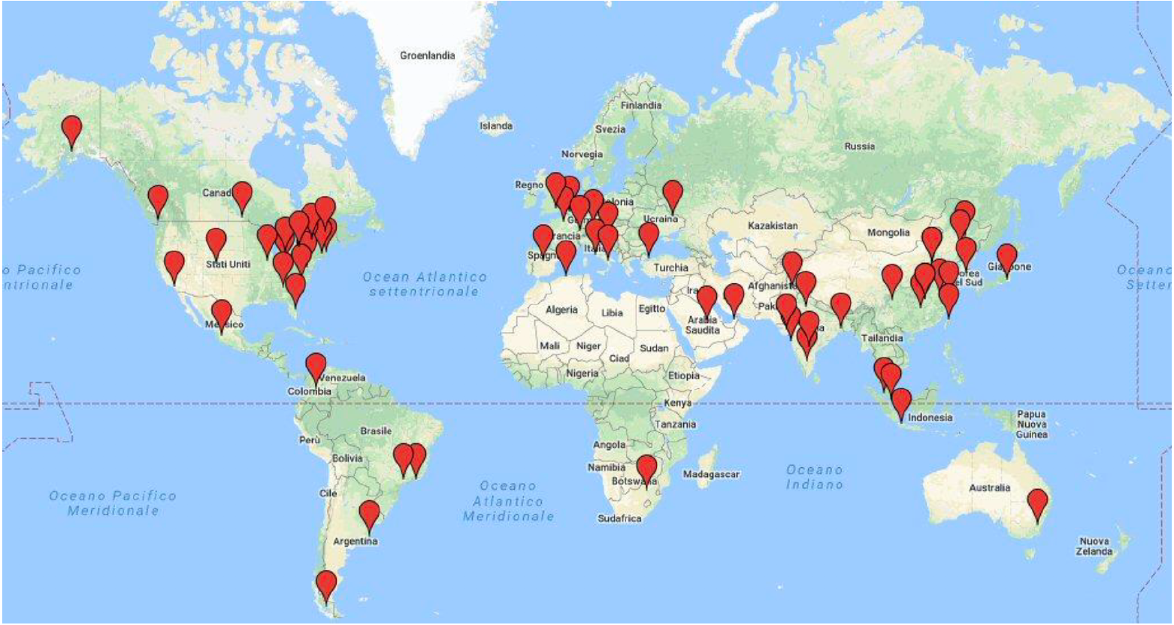
Membership
16 active members in ACT
23 active members in NSW

Slide 3
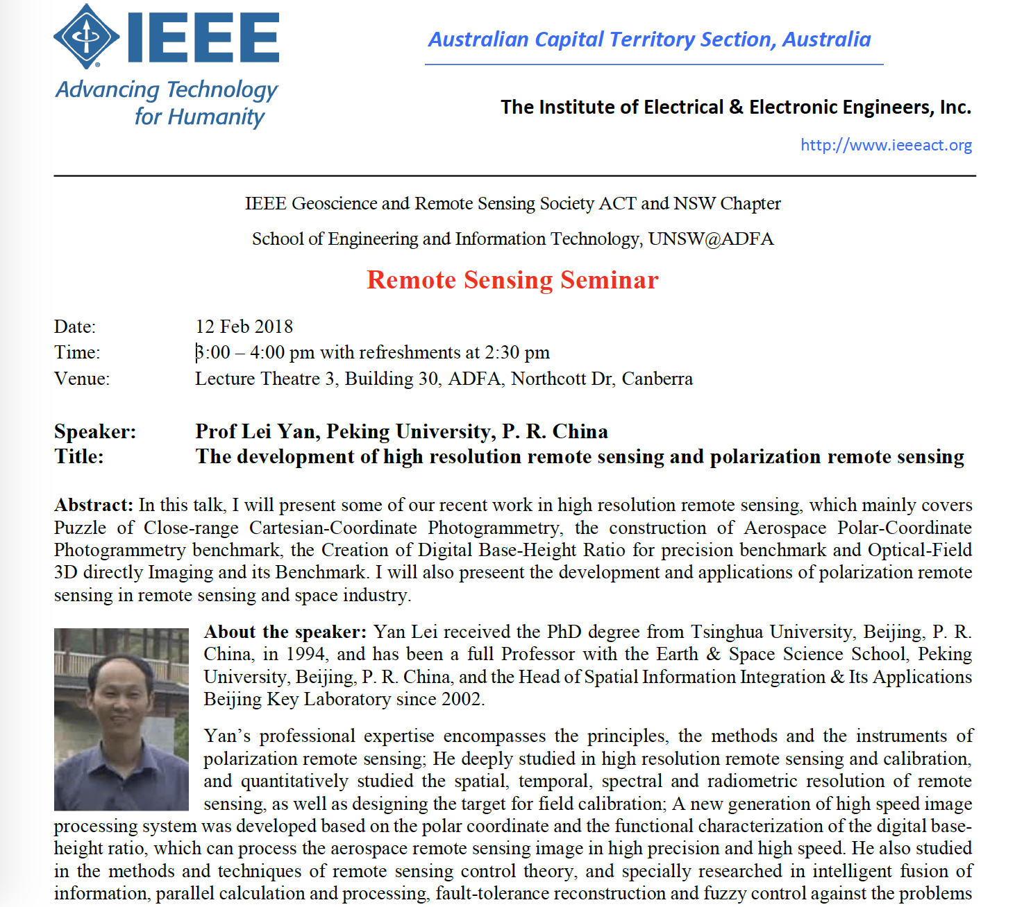
Activities
A seminar by Professor Lei Yan, Peking University, China
Feb 12, 2018
25 attendees
Next seminar by Dr. Jun Zhou Griffith University
Aug 17, 2018
Invite a DL in Dec

Slide 4
Student activities
Successful GRSS Grand Challenge proposal entitled, “A Drone-Based Rice Monitoring System to Support Intelligent Farm Management”
Have a BBQ function in Aug, 2018
Establish a student branch

