Slide 1
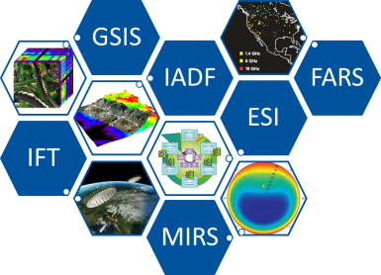
Technical Committees Activities @ the Geoscience and Remote Sensing Society (GRSS)
Irena Hajnsek (ETH/DLR)
VP of Technical Activities
Chapter Chair and Globalization Meeting - Beijing, China, July 10, 2016

Slide 2
Presentation of the TC Team
ID | TC Name | Chair /Co-Chair
ESI | Earth Science Informatics | Peng Yue (Wuhan Uni) Rahul Ramachandran (NASA MSFC) Peter Baumann (Jacobs)
FARS | Frequency Allocations in Remote Sensing | Sidharth Misra (NASA JPL) Paolo de Matthaeis (GSFC)
IADF | Image Analysis and Data Fusion | Devis Tuia (UZH) Gabriele Moser (Uni Genova) Bertrand Le Saux (ONERA)
IFT | Instrumentation and Future Technologies | Boon Lim (NASA/JPL) Marwan Younis (DLR)
GSIS | Geoscience Spaceborne Imaging Spectroscopy | Andreas Mueller (DLR) Cindy Ong (CSIRO) Uta Heiden (DLR)
MIRS | Modeling in Remote Sensing | Jiancheng Shi (RADI) John Kerekes (RIT)
Chapter Chair and Globalization Meeting - Beijing, China, July 10, 2016

Slide 3
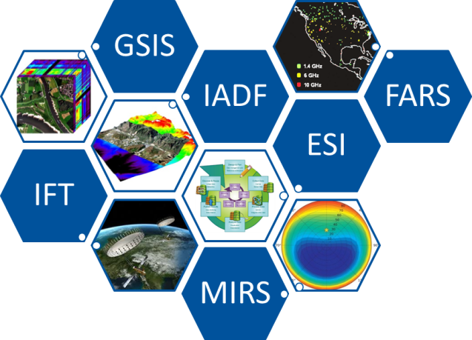
Technical Committees: Mission
Actively promote discussion and advances in areas of member technical interests.
Activities of the Technical Committees include:
networking within the scientific topic,
organization of thematic workshops,
education of young professionals,
organization of special sessions at IGARSS along with hosting a committee meeting open to all IGARSS participants.
Chapter Chair and Globalization Meeting - Beijing, China, July 10, 2016

Slide 4
Common Topics of the Technical Committees
Globalization (workshops, chapters,…)
Education (summerschools, tutorials,…)
Publication (GRSM,…)
Industries (membership,…)
Chapter Chair and Globalization Meeting - Beijing, China, July 10, 2016

Slide 5
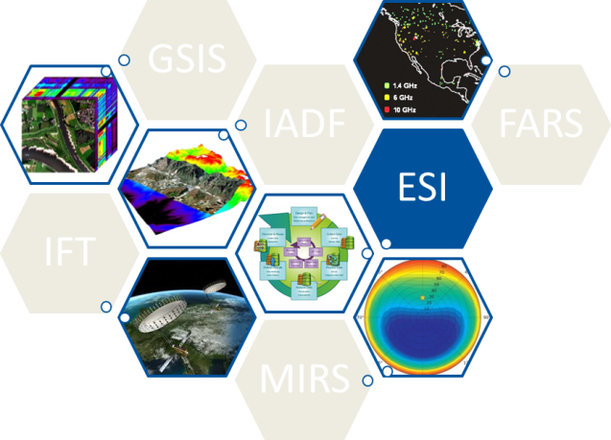
Earth Science Informatics
TC Chairs:
Peng Yue (Wuhan Uni)
Rahul Ramachandran (NASA MSFC)
Peter Baumann (Jacobs)
Contact: esi_chairs@ieee-grss.org
Advance the application of informatics to GRSS;
Provide a venue for ESI professionals to exchange information and knowledge;
Give technology advice to major national and international ESI initiatives;
Area of Interest: Data and information policies, Data stewardship, Sensor web and applications, Cloud computing, Earth system modeling, Emerging information technologies/applications,…
Chapter Chair and Globalization Meeting - Beijing, China, July 10, 2016

Slide 6
ESI has been supporting the international conference series on Agro-Geoinformatics
The Fifth International Conference on Agro-Geoinformatics
Dates: July 18-20 July 2016 (after the IGARSS 2016)
Location: Tianjing, China (a half-hour high-speed train ride from Beijing)
ESI TC is technically co-organizing the conference
Over 250 abstracts received
Chapter Chair and Globalization Meeting - Beijing, China, July 10, 2016

Slide 7
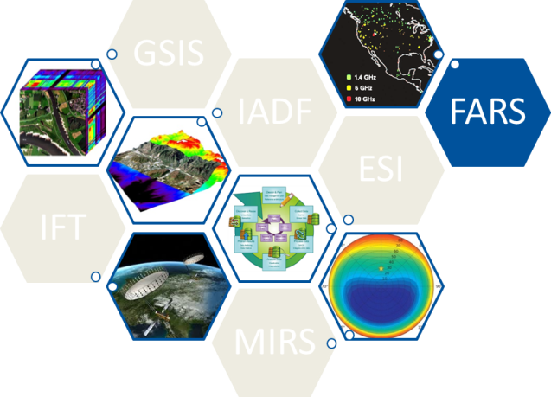
Frequency Allocations in RS
TC Chairs:
Sidharth Misra (NASA JPL)
Paolo de Matthaeis (GSFC)
Contact: fars_chaira@ieee-grss.org
Interact between the GRSS membership and the frequency regulatory process: This includes:
Educating the membership of current frequency management issues,
Influencing regulatory efforts by organizing a GRSS response,
Coordinate GRSS technical recommendations to regulatory organizations,
Track current and future user spectrum requirements,
Investigate potential interference issues and promote the development of interference mitigation techniques.

Slide 8
RFI 2016 Workshop
Workshop being organized to discuss RFI impacting radio astronomy, passive and active remote sensing
150 attendees expected
Date: October 17-22 2016
Place: Socorro, New Mexico
Chapter Chair and Globalization Meeting - Beijing, China, July 10, 2016

Slide 9
FARS Observed Interference Database (RFI)
Chapter Chair and Globalization Meeting - Beijing, China, July 10, 2016
Notes:
GPM-GMI and SMAP have been added
Official documentation submitted in SFCG
Efforts still ongoing to have project cooperate to populate tool
Publish interferer information using a service, which we can then extract
Currently shows EESS only primary/secondary bands
Neighboring allocation also displayed
Radio Astronomy might be added
Standard RFI report card will be generated and modeled after current spectrum interference reporting forms
FARS decision is to open up the tool publically in at the upcoming annual meeting
Initially tool will only be available to GRSS members and members from CORF and SFCG

Slide 10
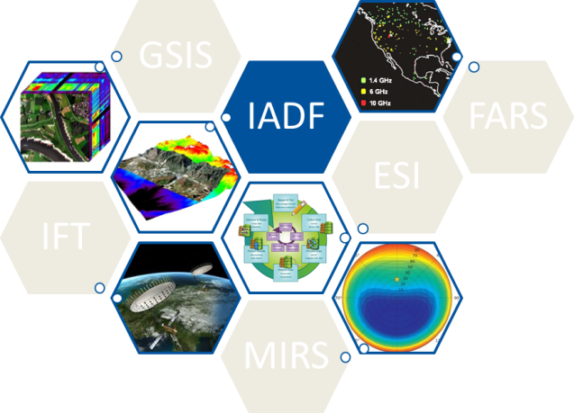
Image Analysis and Data Fusion
TC Chairs:
Devis Tuia (UZH)
Gabriele Moser (Uni Genova)
Bertrand Le Saux (ONERA)
Contact: iadf_chairs@ieee-grss.org
Forms a global discussion forum for data fusion specialists, industry, and general public
Promotes image analysis and data fusion as means to tackle new societal challenges via remote sensing data analysis.
Focus on “multi+” problems: multi-temporal, multi-source, multi-resolution and generally multi-modal data.
Chapter Chair and Globalization Meeting - Beijing, China, July 10, 2016

Slide 11
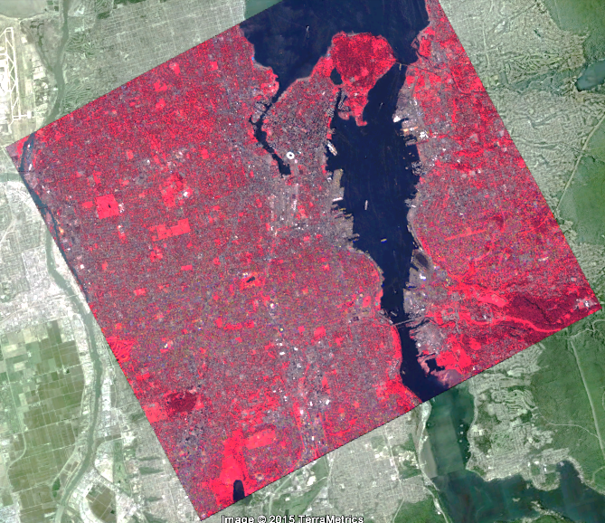
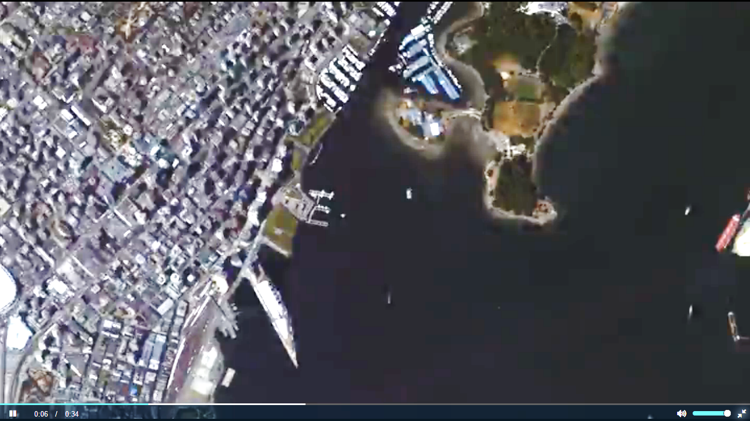
Data Fusion Contest: Yearly Event !
Data (Optical)
Participants
24 Proposals
Awards (1st to 3rd Place)
Methods
Vancouver

Slide 12
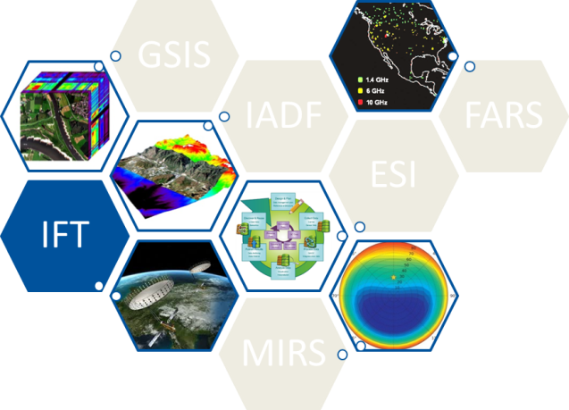
Instrumentation
and Future Technologies
TC Chairs:
Boon Lim (NASA/JPL)
Marwan Younis (DLR)
Contact: ift_chairs@ieee-grss.org
Facilitate, engage and coordinate GRSS members and the communities-at-large to:
assess the current state-of-the-art in remote sensing instruments and technology,
identify new instrument concepts and relevant technology trends, and
recognize enabling technologies for future instruments.
Chapter Chair and Globalization Meeting - Beijing, China, July 10, 2016

Slide 13
Working Groups within IFT
Working Group | Co-Chairs | Organization
Active Microwave | Im, Eastwood | JPL
 | Ludwig, Michael | ESA/ESTEC
Passive Microwave | Colliander, Andreas | JPL
 | McKague, Darren | University of Michigan
Active Optical | Singh, Upendra | NASA Langley Research Center
 | Georgios Tzeremes | ESA/ESTEC
GNSS and Signals of Opportunity | Garrison, James | Purdue University
 | Cardellach, Estel | Institut de Ciencies de l’Espai
Small Satellite | Blackwell, William | MIT LL
 | Lim, Boon | JPL
Chapter Chair and Globalization Meeting - Beijing, China, July 10, 2016

Slide 14
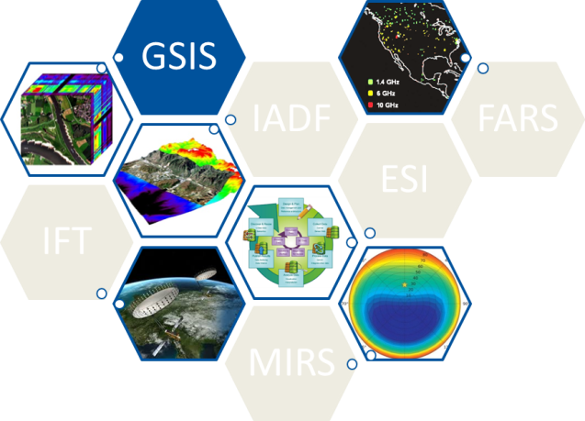
Geoscience and Spaceborne Imaging Spectroscopy
TC Chairs: Andreas Mueller (DLR)
Cindy Ong (CSIRO)
Uta Heiden (DLR)
Contact: gsis_chairs@ieee-grss.org
Share information on future spaceborne imaging spectroscopy (“hyperspectral”) missions,
Provide opportunities for new partnerships (space agencies, commercial spaceborne data providers, research institutions and user community,
Build a knowledge base on underpinning capabilities to enable uptake of spaceborne imaging spectroscopy by the geoscientific community.

Slide 15
Error Budget Training Course
“Reflectance-Based, Imaging Spectrometer Error Budget”
Organizer: Dr Kurtis Thome (NASA Goddard), Mr Chris MacLellan (University of Edinburgh) and Dr Cindy Ong (CSIRO)
Venue: Chinese Academy of Sciences, Olympic Park Campus, Beijing, China
Date: 15-17 July 2016
Program announced at the IGARSS front page!
Chapter Chair and Globalization Meeting - Beijing, China, July 10, 2016

Slide 16
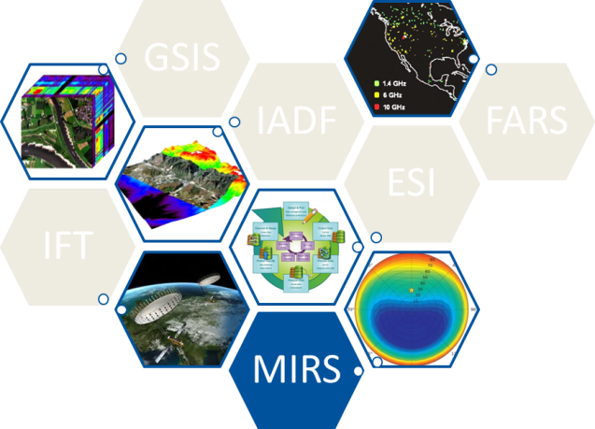
Modeling in Remote Sensing
TC Chairs:
Jiancheng Shi (RADI)
John Kerekes (RIT)
Contact: mirs_chairs@ieee-grss.org
Addresses the technical space between basic electromagnetic theory and data collected by remote sensing instruments.
Focuses on models and techniques used to take geometric, volumetric and material composition descriptions of a scene along with their EM (e.g., scattering, absorption, emission, optical BRDF, dielectric properties, etc.) attribute
Predict for a given remote sensing instrument the resulting observation.
Chapter Chair and Globalization Meeting - Beijing, China, July 10, 2016

Slide 17
Invitation to the Inauguration Meeting
MIRS TC Meeting
Tuesday, 12 July, 17:20-18:30
Room 302A+B
Chapter Chair and Globalization Meeting - Beijing, China, July 10, 2016

Slide 18
Technical Committee Flyer for IGARSS 2016

Slide 19
IGARSS 2016: 12 Invited Session Schedule
TC | Number | Session Title | Time
ESI | I.16 | Earth Observing Data Science | Mon –pm
 | I.7 | Advancing Interoperability for Geoscience Information Systems | Wed – pm
FARS | I.25 | Microwave Remote Sensing and Radio-Frequency Interference | Mon – pm
IADF | I.14 | Data Fusion | Wed – am
 | I.20 | IEEE GRSS Data Fusion Contest | Tue – pm
IFT | I.17 | Earth Remote Sensing with Small Satellites | Thu – pm
 | I.21 | Instrumentation Advances for Reflectometry with GNSS and Signals of Opportunity (GSS+R) | Thu – pm
 | I.18 | Future Digital Beamforming SAR Missions | Tue – pm
ISIS | I.11 | Calibration, Validation and Related Topics in Support of Spaceborne Imaging Spectroscopy Missions | Tue – am
 | I.23 | International Spaceborne Imaging Spectroscopy Missions: Updates and News | Mon – pm
 | I.26 | Minerals and Hydrocarbons | Thu – pm
MIRS | I.31 | Physical Models in Microwave Remote Sensing | Tue - pm

Slide 20
 | Sun | Mon |  |  | Tue |  |  | Wed | Tur |  |  | Fri
8:20-10:00 | Joint Chapter Chairs and Globali-zation Committee |  |  |  | I.11 |  |  | I.14
10:30-12:10 |  |  |  |  | I.11 |  |  | I.14
Lunch
13:30-15:10 |  | I.16 | I. 23 |  | I.31 |  |  | I.7 | I. 17 | I. 21 | I.26
15:40-17:20 |  | I.16 | I. 23 | I. 25 R | I.31 | I.20 DFC | I.18 | I.7 | I. 17 | I. 21 | I.26
Evening Meeting 17:20-18:20 |  | ESI Room 306A | ISIS Room 310 | FARS Room 306B | MIRS Room 302A+B | IADF Room 306A | IFT Room 309A
19:00-open end |  |  |  |  |  |  |  | Dinner TC/CC
Chapter Chair and Globalization Meeting - Beijing, China, July 10, 2016

Slide 21
Reporting Activities @ Geoscience and Remote Sensing Magazine (GRSM)
Example FARS: GRSM March 2016

Slide 22
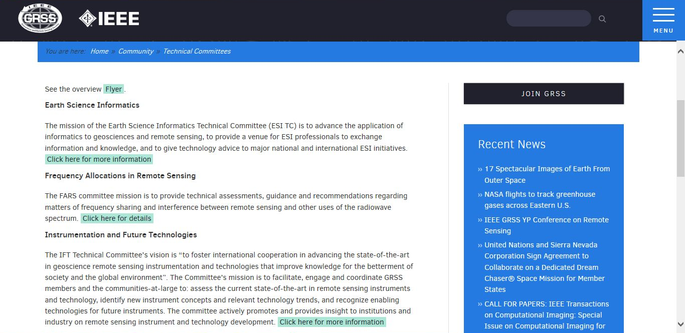
Join us @ http://www.grss-ieee.org/community/technical-committees/
Chapter Chair and Globalization Meeting - Beijing, China, July 10, 2016

