Slide 1
IEEE GRSS Beijing Chapter
Presented by : Xiaolong DONG
On behalf of Prof. Ji Wu
July 10, 2016

Slide 2
OUTLINE
About Beijing Chapter
2. Chapter Activities since 2015
3. Future Plans

Slide 3
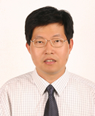
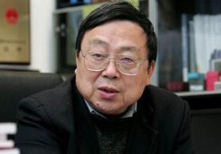
About Beijing chapter
Chapter Established: 1998
Chapter Chair from 1998-2012
Yaqiu JIN (Fudan Univ.) Chao WANG (RADI, CAS)
IEEE Fellow IEEE Senior Member

Slide 4
About Beijing chapter
From July 2012
Chapter Chair: Ji WU (NSSC, CAS), IEEE Fellow
Chapter Vice-Chairs:
Jiancheng SHI (RADI, CAS), IEEE Fellow
Peng ZHANG (NSMC, CMA)
Qiming ZENG (Peking Univ.)
Wen HONG (Institute of Electronics, CAS)
Hong ZHANG (RADI, CAS)
IEEE GRSS Member: ~ 290

Slide 5
About Beijing chapter
How we operate?
Strategic Meeting (Chapter Chairs)
GRSS Membership Promotion
Conferences
Lectures

Slide 6
OUTLINE
1. About Beijing Chapter
2. Chapter Activities since 2015
3. Future Plans

Slide 7
Chapter Activities since 2015
“Electromagnetic Diffraction Modeling and Simulation”
---By Levent Sevgi, Okan University, Turkey, Apr. 6, 2015.
GRSS Distinguished Lecturer
“Advanced Neural Adaptive Prosessing in Interferometric and Polarimetric Radar Imaging”
---By Akria Hirose, Tokyo University, Japan, December 11, 2015.

Slide 8
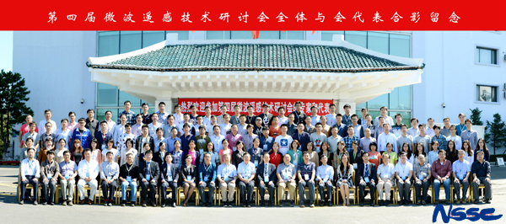
Chapter Activities since 2015
Sponsoring conferences
4th Microwave Remote Sensing Technology Workshop
September 7-10, 2015 in Yanji, Jilin Province, China. (2nd time with GRSS Beijing Chapter sponsorship)
~140 participants from >40 research institutes, universities and industry.
3 students awarded ”Best Student Paper Award”

Slide 9
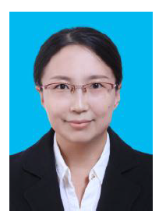
Chapter Activities since 2015
Recruitment for GRSS Asia Pacific Region Manager (together with IEEE Beijing Office & GRSS)
To design, develop and implement the Strategic Plan in order to increase membership and
to grow the participation of Chinese remote sensing and spatial information scientists
and engineers in IEEE and GRSS activities
Qiang YIN, Ph. D on Signal and Information Processing
( 2 years part time in IEEE Beijing Office starting from March 2016 )

Slide 10
Chapter Activities since 2015
Involvement in GRSS meetings
Prof. Wu Ji, Chair of GRSS Beijing Chapter participated in the Chairs Strategic meeting on July 26, 2015 and presented Beijing Chapter’s activities plus a very brief introduction of IGARSS 2016.
Prof. Wu Ji also attended AdCom meeting held 6-8 November, 2015 in Michigan, USA. During the meeting, he delivered a detailed report of the progress of IGARSS 2016.
Prof. Shi Jiancheng, GRSS AdCom member and vice chair of GRSS Beijing Chapter participated in the AdCom meeting held both in March and November, 2015.
Co-organizing the preparation meeting of IGARSS 2016 as well as undertaking the specific tasks related to IGARSS 2016 such as the publicity, sponsorship, exhibitions etc.

Slide 11
Chapter Activities since 2015
2015 IEEE GRSS Chapter
Excellence AWARD

Slide 12
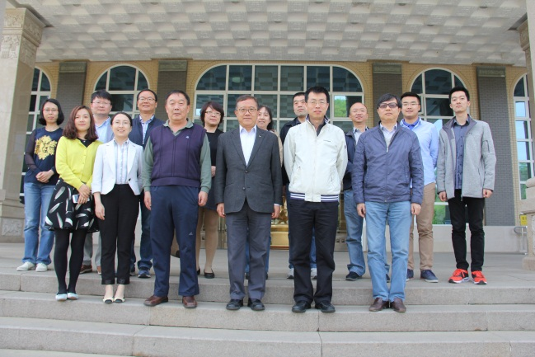
Chapter Activities since 2015
IEEE GRSS Chapter Chair Meeting in China
( April 23, 2016, Beijing)
Chair: Prof. WU Ji, Chair of GRSS Beijing Chapter
Attendances:
Chairs/Vice Chairs of GRSS Chapters in China
Contact persons of potential Chapter
IGARSS 2016 Local Organization Committee
Representative of IEEE Beijing Office
Topics:
Promotion of IGARSS 2016; Promotion of GRSS membership; Promotion of GRSS Chapters.
Next Meeting: September, 2016

Slide 13
Chapter Activities since 2015
Report on Activities by Beijing Chapter
will be published in December 2016 in
IEEE Geoscience and Remote Sensing
Magazine ( GRSM)

Slide 14
Chapter Activities since 2015
Co-organizing IGARSS 2016

Slide 15
Chapter Activities since 2015
IGARSS 2016 Overview
Registration status
Numbers | 1813
Countries and Regions | 50
Up to July 7

Slide 16
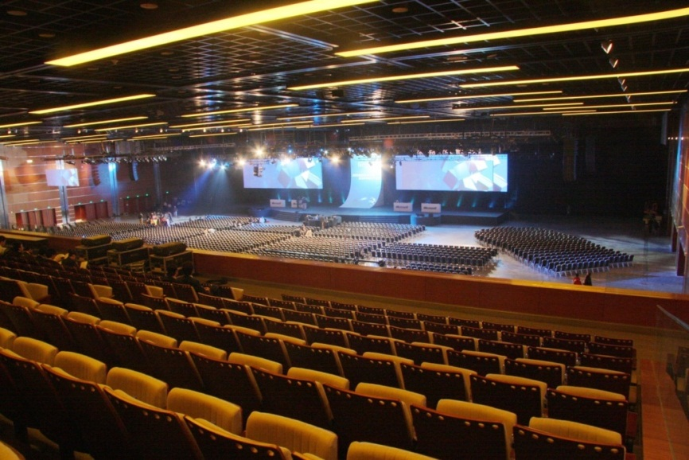
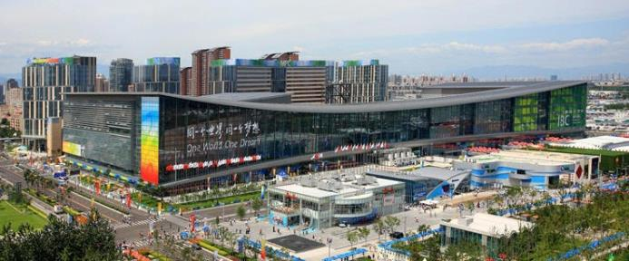
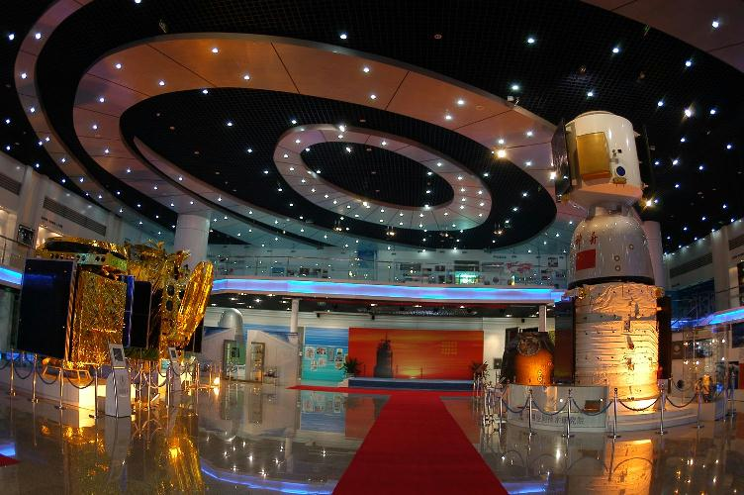
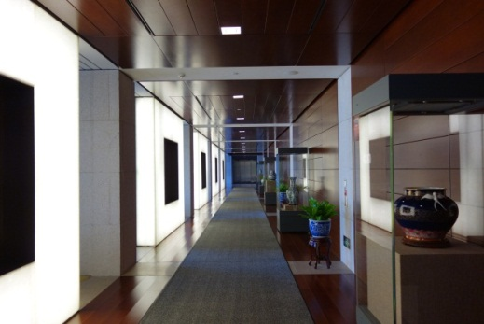
Chapter Activities since 2015
Co-organizing IGARSS 2016

Slide 17
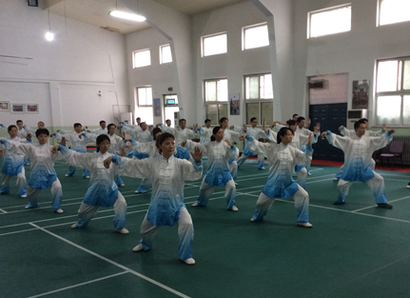
Chapter Activities since 2015
Co-organizing IGARSS 2016
Beijing Chapter vice-chair (Wen HONG) participating Taiji performance for IGARSS 2016 reception.

Slide 18
OUTLINE
About Beijing Chapter
2. Chapter Activities since 2015
3. Future Plans

Slide 19
Future Work Plans
What we will do next?
IGARSS 2016
Chapters Promotion
promote the establishment of Changchun Chapter and Xi’an Chapter
and even more chapters in 2016/2017
Membership Promotion
GRSS China Chapters/Potential Chapters Forum
September 2016, Chengdu
(Half day seminars + Half day discussions)
Start preparation of the 5th Microwave Remote Sensing Technology Workshop (to be held in 3rd quarter of 2017）
Lectures

Slide 20
Thank you!

